Slide 1
Design and Development of an Offline-First Edge-IoT System for Cold-Chain Risk Monitoring and Safe Holdover Time Prediction
FOCUS : offline operation, local prediction, last-mile transport support, power-failure resilience, or lower-cost deployment for smaller facilities
Vaccines – +2 °C to +8 °C
two temperature zones, local decision-making, local storage, and multi-path alerting ( Air and Inside Box ) - glycol or a thermal dummy load
Door events and power states, trigger alerts for electrical cutoffs and prolonged door openings
local data storage, RTC-backed timestamps and microSD storage
remaining time to threshold excursion – Safe Holdover Time
continue sensing during power and network failures, estimate time-to-risk before an excursion, distinguish likely causes such as door-open versus power-cut versus compressor anomaly, and then synchronize records later for auditability.

Slide 2
Knowledge Track
Embedded sensor interfacing
Edge analytics
LoRa, BLE or GSM communication
Network-failure resilience
Local databases and store-and-forward protocols
Time-series analysis
Low-power operation
Dashboard and alert-system development

Slide 3
OUTCOMES
Offline edge prediction, without depending on the cloud
Separate air-temperature and product-simulation temperature measurements
Time-to-threshold estimation, rather than only detecting a completed excursion
Classification of likely causes such as door opening, power loss and abnormal compressor cycling
Local operation during power and network failures
Store-and-forward audit logging
A common architecture for both refrigerators and last-mile cold boxes

Slide 4
Novelty Claims
Product-zone thermal prediction: Uses a buffered product-simulation probe instead of relying only on refrigerator air temperature.
Safe-holdover-time estimation: Predicts the estimated time remaining before the configured threshold is reached.
Cause-aware alerting: Separates door-open, power-failure, abnormal cooling and communication-failure events instead of generating one generic temperature alarm.
Fully offline operation: Detection, prediction, logging and local alarms continue without internet access.
Store-and-forward communication: Data lost during network failure is recovered and synchronised after reconnection.
Multi-context deployment: The same controller can be tested in a refrigerator and an insulated last-mile transport box.
Low-cost rural deployment: The design targets primary health centres, small pharmacies, diagnostic laboratories and rural medicine-storage facilities.

Slide 5
Literature Study
refrigerator node works autonomously, then sends short event messages over GSM, LoRa, or Bluetooth only when needed.
fault classification from temperature patterns, synthetic datasets generated from thermodynamic models
convolutional autoencoder on an ESP32, for real-time anomaly detection in vaccine refrigeration, reporting 92% fault-detection accuracy, low energy use of 0.05 W, and about 1.2 MB memory use

Slide 6
BLOCK DIAGRAM
Pharmaceutical Cold Storage Unit
Environmental and Product Sensors
Equipment, Door and Power Monitoring
ESP32 Controller
CONTROLLER FUNCTION
Sensory Data Acquistion
Calibration and Filtering
Feature Extraction
Risk Classification Thermal Prediction
Safe Holdover Time Estimation
OUTPUT
OLED Display – Temperature Status and Predicted SHT
Gateway and Dashboard- Graphs and Audit Logs
Mobile or SMS Alert
Buzzer and LED – Local Alarm
Time, Storage and Connectivity
Storage and Forward System – Synchronization after Reconnection
Local and Remote Outputs

Slide 7
Components Identified
Two DS18B20 temperature probes
SHT31 humidity sensor
Magnetic door switch
Isolated mains-status detection
DS3231 RTC
MicroSD logging
OLED and buzzer
ESP32
Battery backup
LoRa or GSM as the remote-alert channel
Rule-based time-to-threshold prediction initially

Slide 8
DEFINED BLOCK DIAGRAM
PHARMACEUTICAL COLD-STORAGE UNIT
DS18B20 Probe 1
Air Temp
DS18B20 Probe 2
Product-Sim Temp
SHT31 Sensor
Humidity
Magnetic Reed Switch
Door Open/Closed
Isolated Mains Detector
Power Availability
Compressor Current Sensor
Compressor ON/OFF Cycles
Battery-Voltage Monitoring
Sensor acquisition
Calibration/filtering
  Feature extraction
  Risk classification
  Thermal prediction
  Safe Holdover Time
ESP32 CONTROLLER
DS3231 RTC
Accurate Timestamp
MicroSD Module
Offline Storage
Communication Module
Wi-Fi / BLE / LoRa / GSM
STORE-AND-FORWARD SYSTEM
Synchronization after reconnection
OLED Display
Temp, status, & SHT
Buzzer / LED
Local Alarm
Gateway / Dashboard
Graphs & audit logs
Mobile / SMS Alert

Slide 9
POWER SUPPLY SECTION BLOCK DIAGRAM
AC Mains Supply
AC-DC Regulated Power Supply
ESP 32 and Sensors
Battery Charger / UPS Module
Rechargeable Backup Battery
Automatic Operation During Power Failure

Slide 10
STAGES
Data-Acquisition Stage
Sensors → ESP32 acquisition → Sensor calibration → Noise filtering → RTC timestamping → MicroSD logging
Risk-Analysis Stage
Temperature and operational data → Feature extraction → Risk identification → Risk-level classification
Prediction Stage
Product temperature → Temperature-rise calculation → Thermal prediction model → Safe Holdover Time estimation
Alert Stage
Risk classification → Local OLED/buzzer alert → Remote LoRa/GSM/Wi-Fi alert
Offline Synchronisation Stage
Communication unavailable → Local storage → Connectivity restored → Automatic record synchronisation → Dashboard update

Slide 11
REVIEW 1 — SYSTEM DESIGN AND SENSOR DEVELOPMENT
Complete the detailed literature survey, finalise the problem statement, identify the research gap, define the system requirements and prepare the complete hardware and software architecture.
Procure and interface the temperature, humidity, door, power, compressor and battery sensors; calibrate the sensors and demonstrate real-time readings through the OLED or serial monitor.
Expected Review 1 Output
Finalised system architecture
Complete component selection
Sensor-interfacing circuits
Air- and product-temperature measurement
Door-state detection
Power-failure detection
Local display and basic alarm
Preliminary sensor-calibration results

Slide 12
REVIEW 2 — OFFLINE IoT AND PREDICTION DEVELOPMENT
Implement RTC-based timestamping, microSD data logging, communication-failure detection, offline record storage and store-and-forward data synchronisation.
Conduct controlled door-open and power-cut experiments, extract temperature-rise characteristics and develop the risk-classification and Safe Holdover Time prediction algorithms.
Expected Review 2 Output
RTC-based data logging
Offline microSD storage
Wi-Fi, BLE, LoRa or GSM communication
Store-and-forward synchronisation
Door-open risk detection
Power-failure risk detection
Preliminary thermal model
Initial Safe Holdover Time prediction
Preliminary dashboard

Slide 13
REVIEW 3 — COMPLETE INTEGRATION AND VALIDATION
Integrate the complete sensing, communication, prediction, alerting and backup-power sections inside a suitable enclosure and perform continuous real-time testing.
Evaluate the prototype under power failure, prolonged door opening, network loss, low battery, abnormal cooling and sensor-placement conditions and document the final results.
Expected Review 3 Output
Fully integrated prototype
Final enclosure
Complete dashboard
Local and remote alerts
Validated Safe Holdover Time model
Performance-comparison tables
Continuous experimental results
Final project report and demonstration

Slide 14
FEATURE-WISE COMPARISON
Feature | Existing System | Proposed System | Remarks
Temperature Monitoring | Manual checking / periodic data logging | Continuous real-time monitoring | Faster detection of temperature excursions
Data Logging | Paper-based / limited digital records | Automatic digital data logging | Reduces human error and provides traceability
Alert Mechanism | Delayed or manual response | Instant SMS/App/Email alerts | Enables corrective action before vaccine damage
Power Backup | Limited/no monitoring during power loss | Rechargeable battery backup | Maintains monitoring during outages
Connectivity | Standalone operation | Wi-Fi / GSM / LoRa connectivity | Enables remote supervision
Location Tracking | Generally unavailable | GPS-based tracking | Provides visibility during transportation
User Interface | Basic/no centralized interface | Web/mobile dashboard | Live status, history and alerts
Reports | Manual preparation | Automatic reports | Supports documentation and compliance
Scalability | Device-level monitoring | Multi-box / fleet-level monitoring | Suitable for large deployments
Cost Efficiency | Higher operational loss due to delayed detection | Low-cost IoT architecture | Reduces wastage and monitoring effort

Slide 15
COMPONENTS REQUIRED
Estimated Prototype Cost: ₹10,000–₹12,000
Component | Specification | Approx. Price
ESP32 | Dual-core, Wi-Fi + Bluetooth | ₹400–550
DS18B20 | −55°C to +125°C, digital temperature sensor | ₹60–120
DHT22 | Temperature + humidity, ±2% RH | ₹200–250
Magnetic Door Sensor | Reed switch | ₹30–50
Vibration Sensor | SW-420 / accelerometer | ₹50–100
LDR | Light detection | ₹20–30
NEO-6M GPS | GPS/GNSS receiver | ₹250–450
SIM800L | GSM/GPRS communication | ₹350–500
OLED/LCD | 0.96″ OLED / 16×2 LCD | ₹160–300
Micro-SD Module + Card | Local data logging | ₹200–300
Li-ion Battery | 3.7 V, ~5000 mAh | ₹400–500
TP4056 | Li-ion charging/protection | ₹20–60
Insulated Vaccine Carrier | ~2–3 L, PUF insulation, ice packs | ₹1,600–2,600
Enclosure + PCB + Wiring | Protective electronics housing | ₹400–600

Slide 16
Market Reach
Primary Target Market
1. Government Immunization
Universal Immunization Programme
PHCs, CHCs and District Hospitals
Mobile vaccination/outreach teams
Rural and tribal healthcare centres
2. Pharmaceutical & Vaccine Industry
Vaccine manufacturers
Pharma distributors
Medical logistics providers
Temperature-sensitive biologics
3. Healthcare
Hospitals and clinics
Diagnostic laboratories
Blood and biological-sample transportation
4. Other Cold-Chain Sectors
Dairy and food products
Fisheries and meat
Fruits, vegetables and horticulture
Specialty pharmaceutical products

Slide 17
Deployment Model
Market Positioning - Low-cost IoT retrofit for existing vaccine carriers rather than replacing the entire cold-chain infrastructure.
Manufacturer → Central Warehouse → State Warehouse → District Store → PHC/CHC → Mobile Health Worker → Patient

Slide 18
Existing Competitors & State of Art
Company / Solution | India Presence | Core Capability | State-of-Art
Blackfrog Technologies – Emvólio | Karnataka; deployed across 16 Indian states | Portable active vaccine refrigeration | Advanced portable refrigeration + temperature control
GND Solutions | India | In-transit, cold-room & last-mile monitoring | IoT sensors + gateways + cloud + analytics
Mindlabs | Hyderabad | Pharma IoT monitoring | Real-time sensors, GPS, AI analytics, compliance reporting
PIPRA Solutions | India | Vaccine track & trace | End-to-end visibility, IoT, APIs/SDKs
Orvi Networks | India | IoT cold-chain monitoring | Wireless sensors, GPS, cloud dashboard
Trackster Technologies | India | Cold-chain logistics | Temperature + humidity + GPS + cloud
Kelfos Instruments | India | Pharma cold-chain monitoring | IoT temperature/humidity monitoring + alerts
KELZIX | India | Pharmaceutical cold-chain compliance | Multi-sensor monitoring, automated compliance and audit trail

Slide 19
Differentiation
Existing Market | Proposed Project
Enterprise-oriented systems | Low-cost academic/SME deployable system
Monitoring platforms often require dedicated infrastructure | Retrofit onto existing vaccine carrier
Focus on logistics/warehouse scale | Strong focus on last-mile carrier
Higher deployment complexity | ESP32-based compact architecture
Primarily temperature/logistics monitoring | Temperature + humidity + opening + vibration + light + GPS
Cloud-dependent implementations | Local logging + connectivity-based synchronization
High initial deployment cost | Target prototype: ₹4–6k

Slide 20
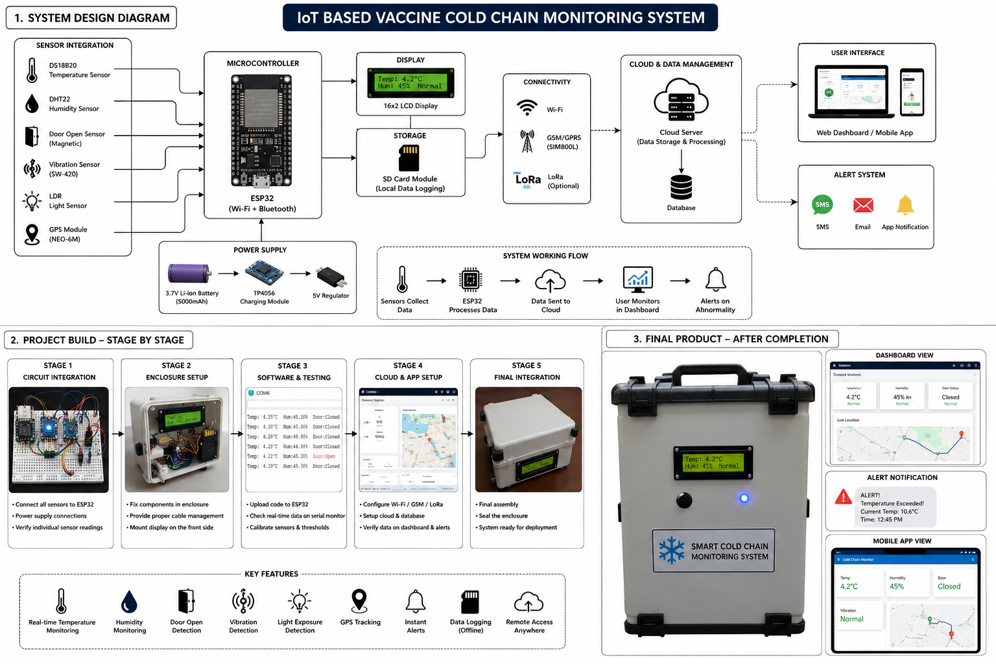

Slide 21
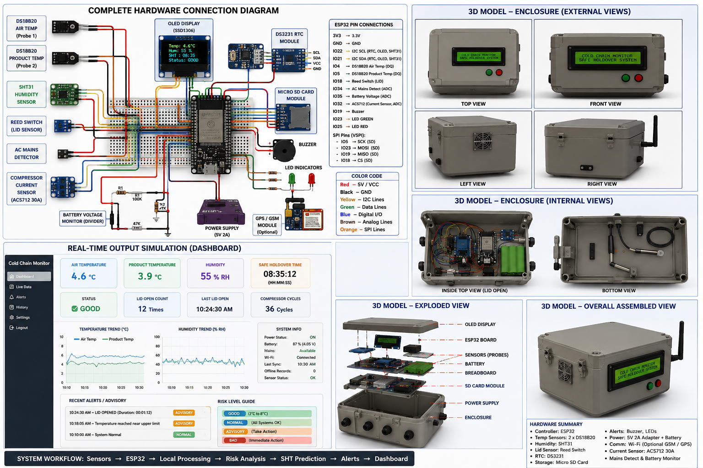

Slide 22
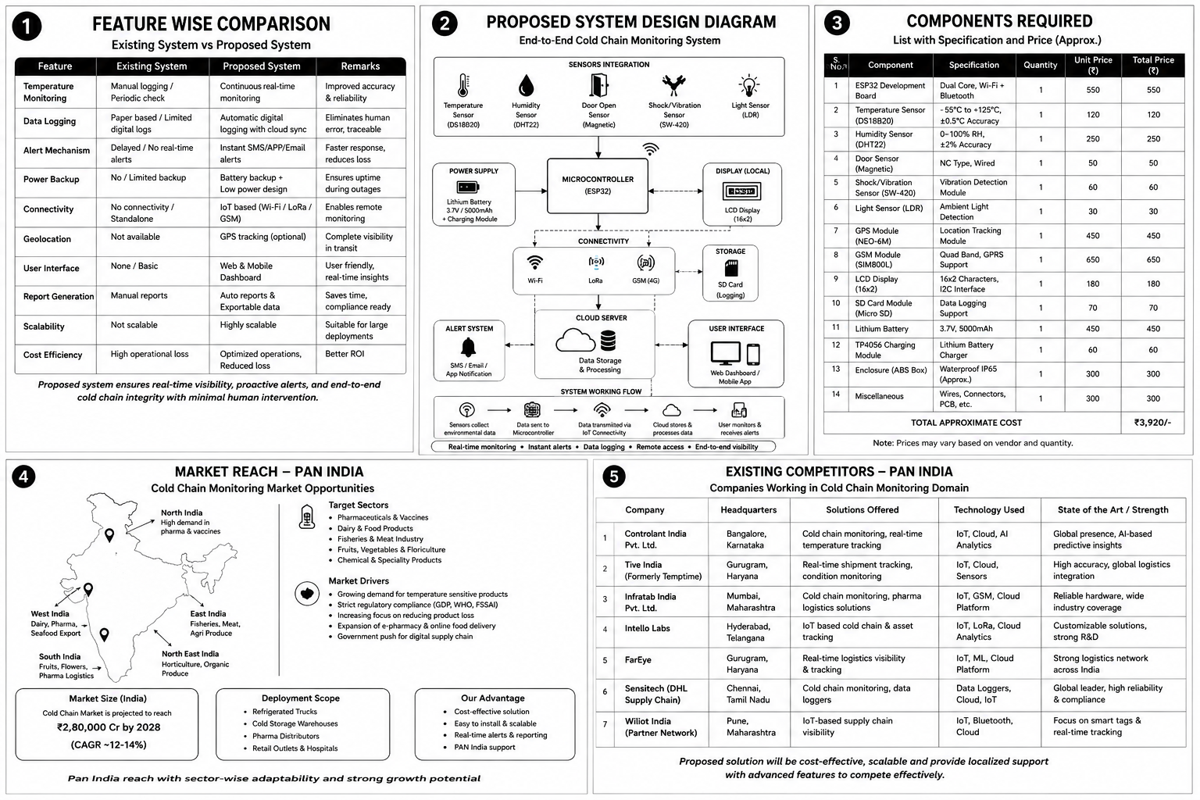

Slide 23
IS IndoSurgicals Small Vaccine Carrier With 2 Icepacks - 0.80 L - https://amzn.in/d/0flGpfd8
Cambia Vaccine Carrier Box (Small with 2 Ice Packs - 0.80 LTR.) - https://amzn.in/d/0bEYdZy9
Vaccine Carrier Box - 0.9LTR Mini Carrier Box with 2 Ice Pack Temperature Controller Multipurpose Storage for vaccine and other products Box- 0.90 LTR (Grey) (Pack of 1) - https://amzn.in/d/0hsPtd16
2MM EPE Foam Wrap | Packing Roll | 1 feet by 20 feet long roll | 6 Meter Roll - https://amzn.in/d/05NAAnln

Slide 24
Justification for the product
Medicines and other products that require cold chain
Novelty of the Proposed System
Need for IOT in cold chain
Complete Scenario of the product

